Slide 1
Telemetry (Power BI) app scenarios

Slide 2
Usage
Errors
Performance
Administration

Slide 3
Usage

Slide 4
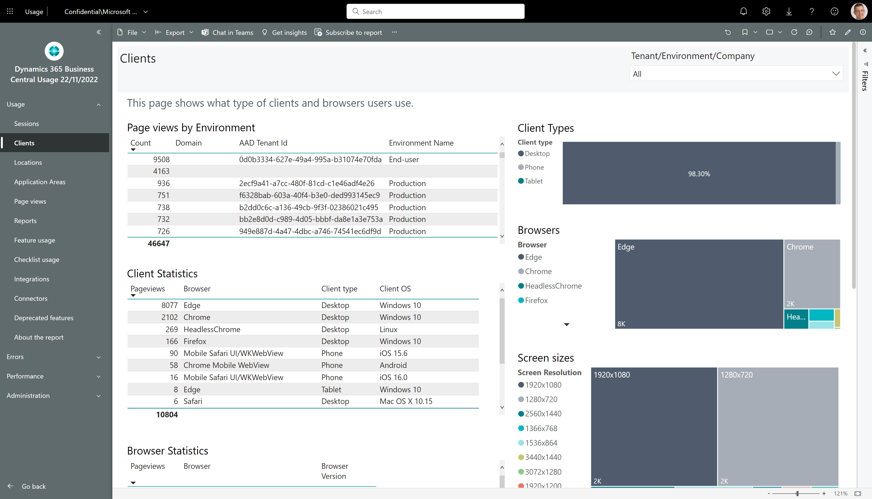
How to see which clients the users at customer use

Slide 5
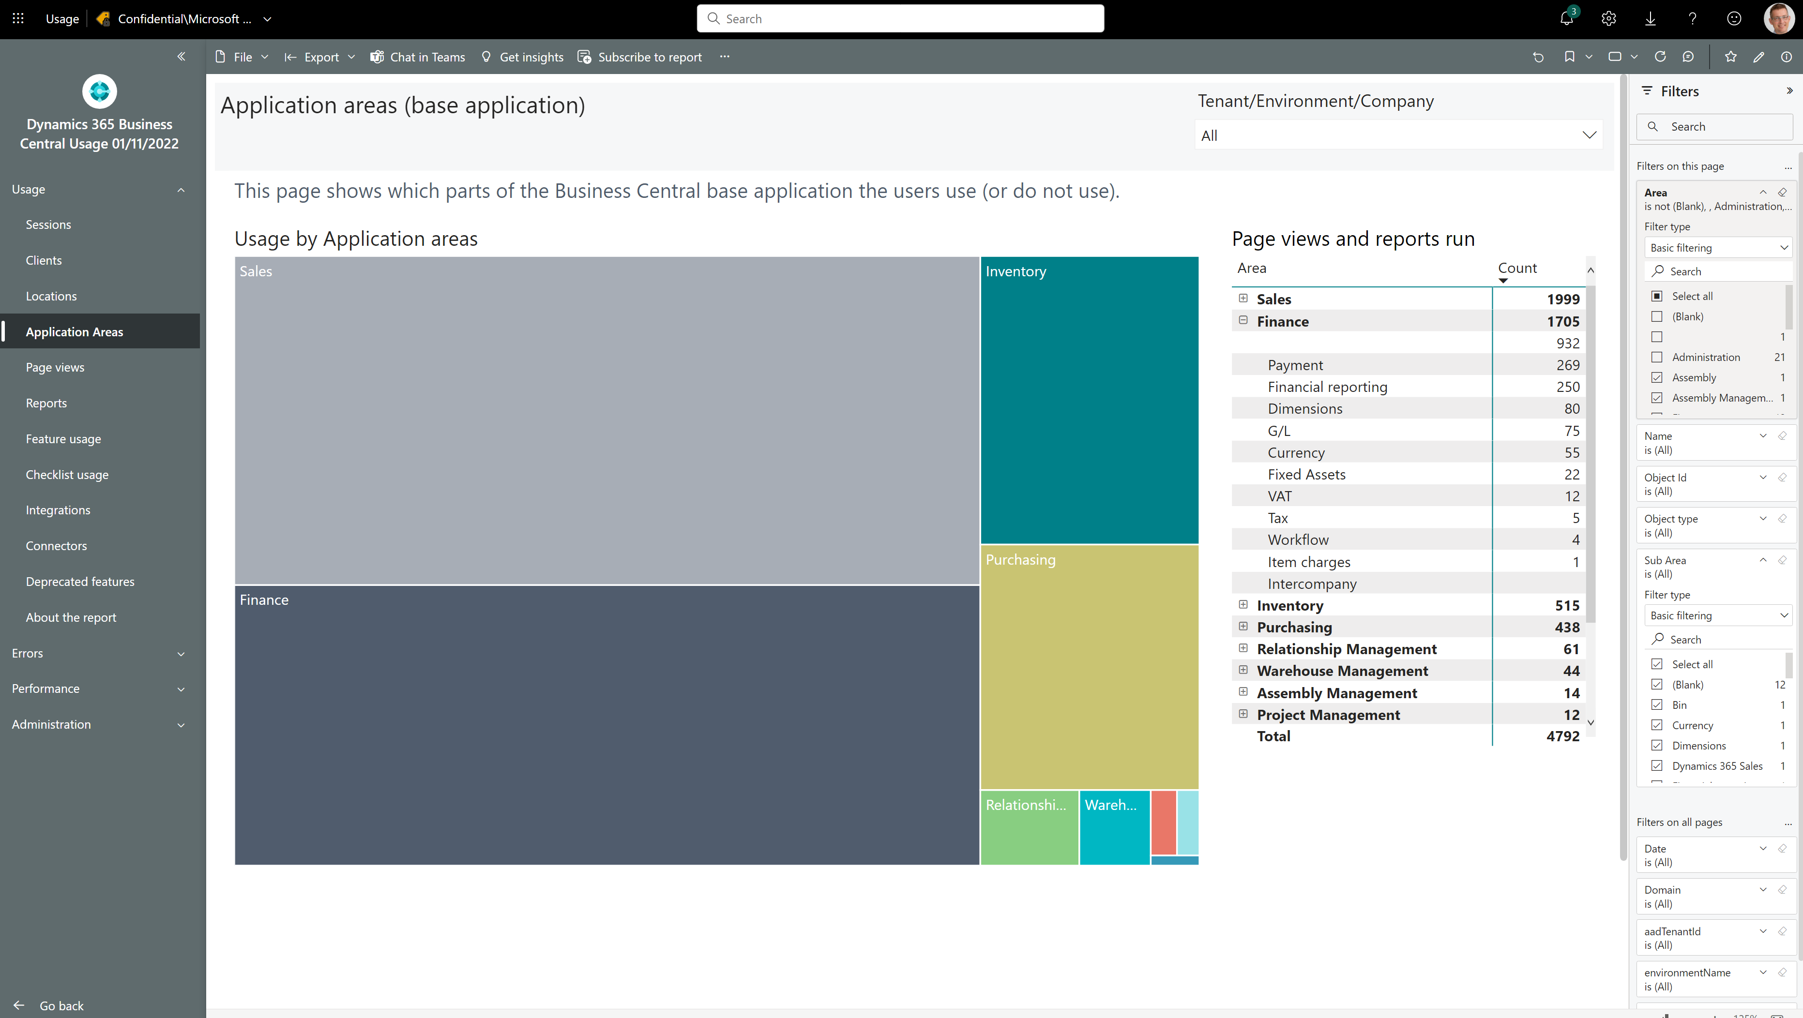
How to see which standard features customers use
Notes:
Filter away Areas with Empty, Bland, Administration, or Other

Slide 6
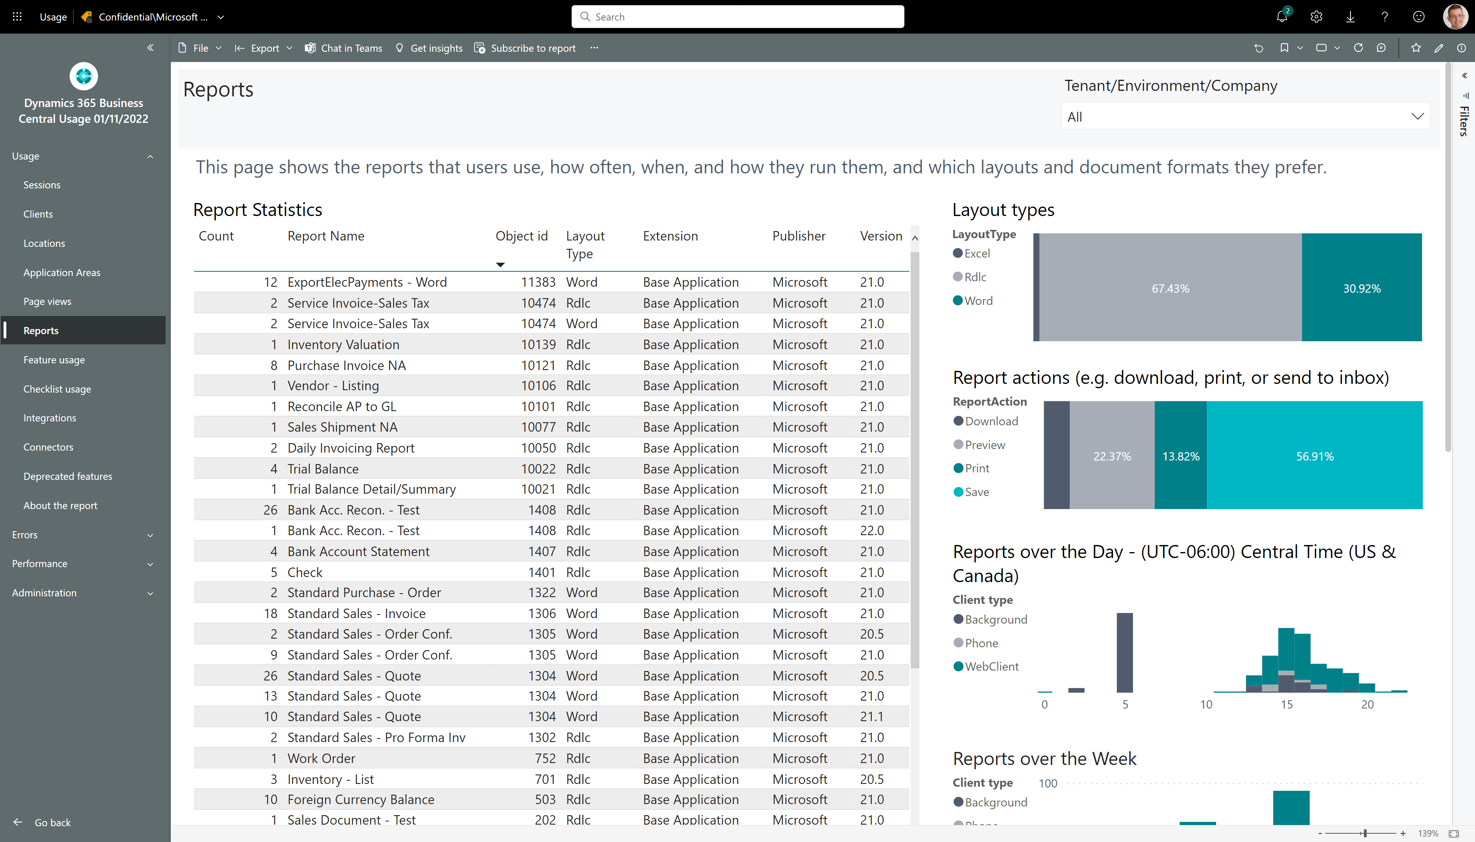
How to see if customer is using Excel layouts

Slide 7
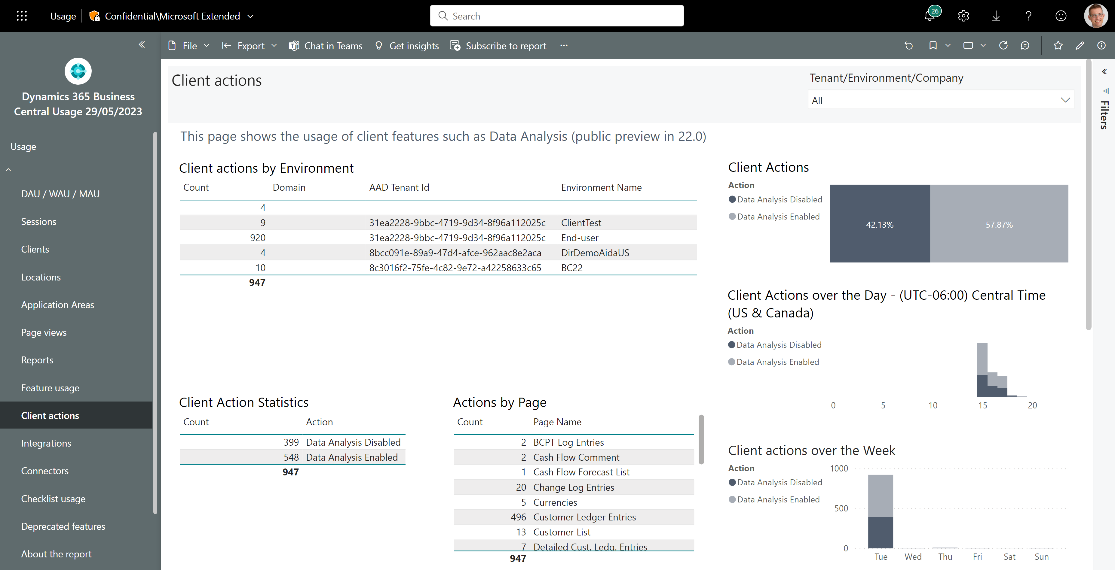
How to see if customer is using Data Analysis
Usage across customers
On which pages do they analyze data?

Slide 8
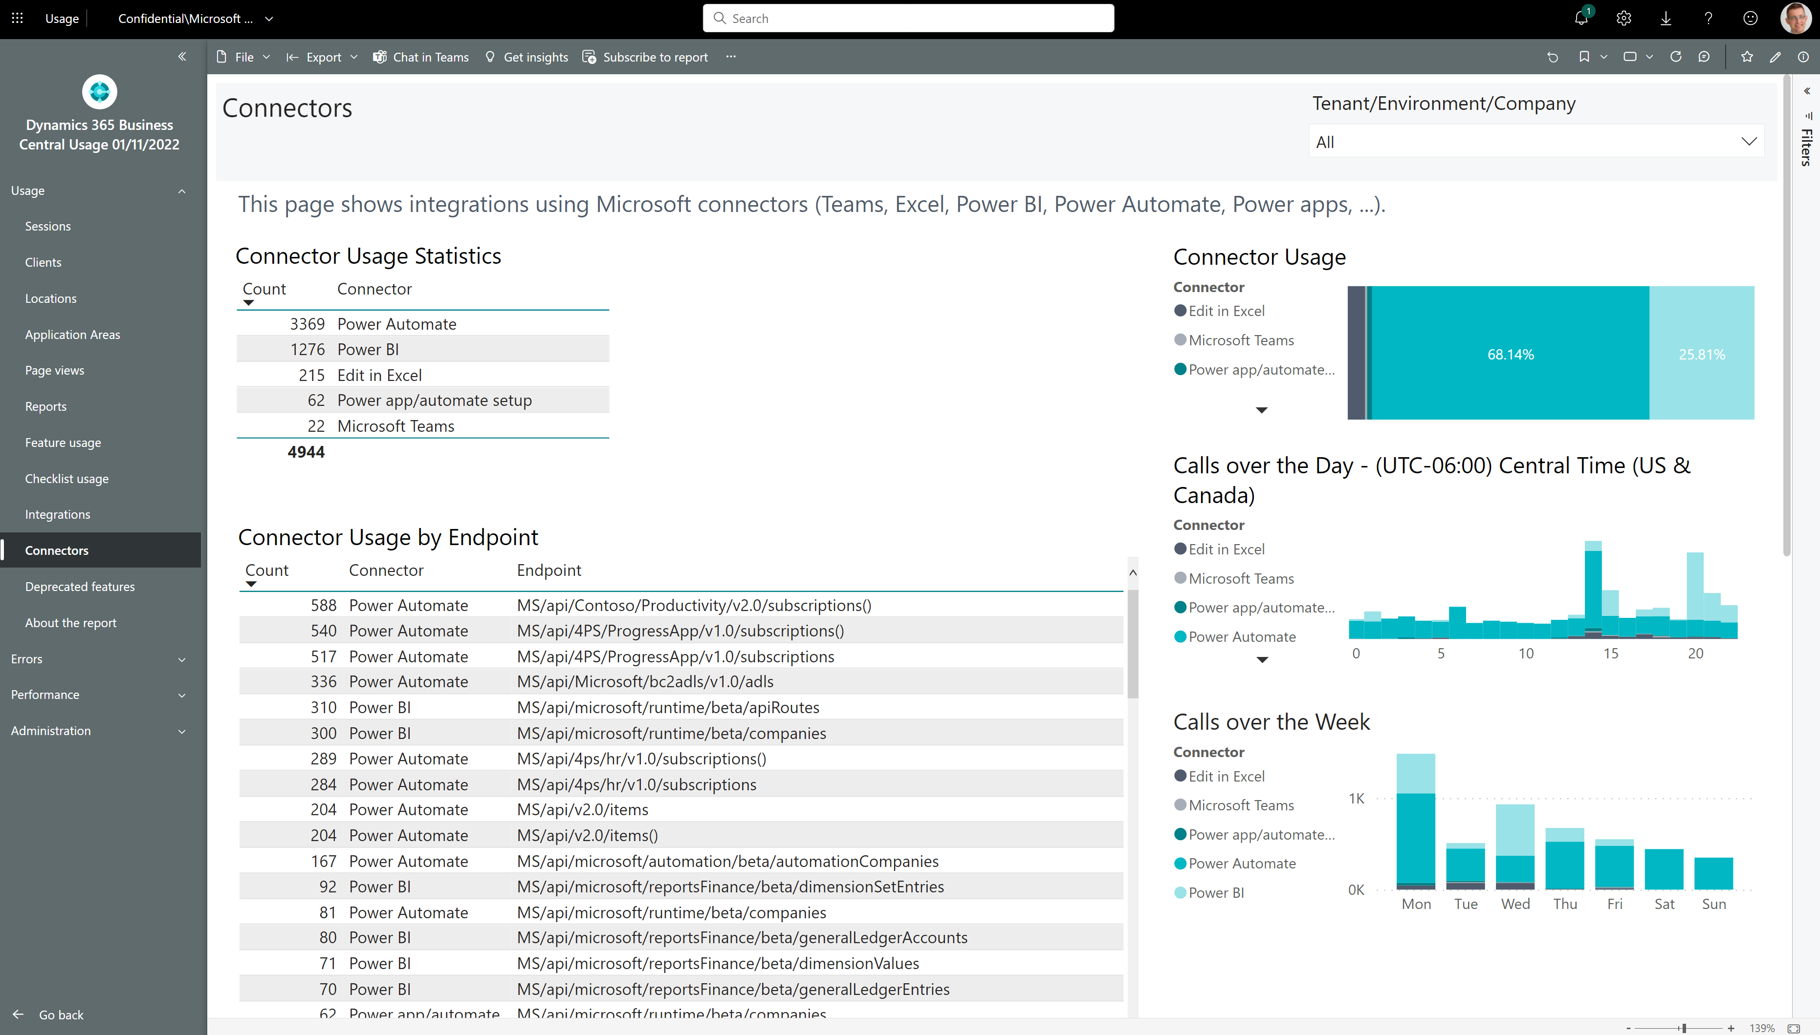
How to see if customer is using Microsoft connectors

Slide 9
Errors

Slide 10
Performance

Slide 11
Tuning outgoing web service calls
Four things to consider:
Tune slow endpoints
Reduce aggressive calls
Fix non-200 HTTP errors (these just waste resources)

Slide 12
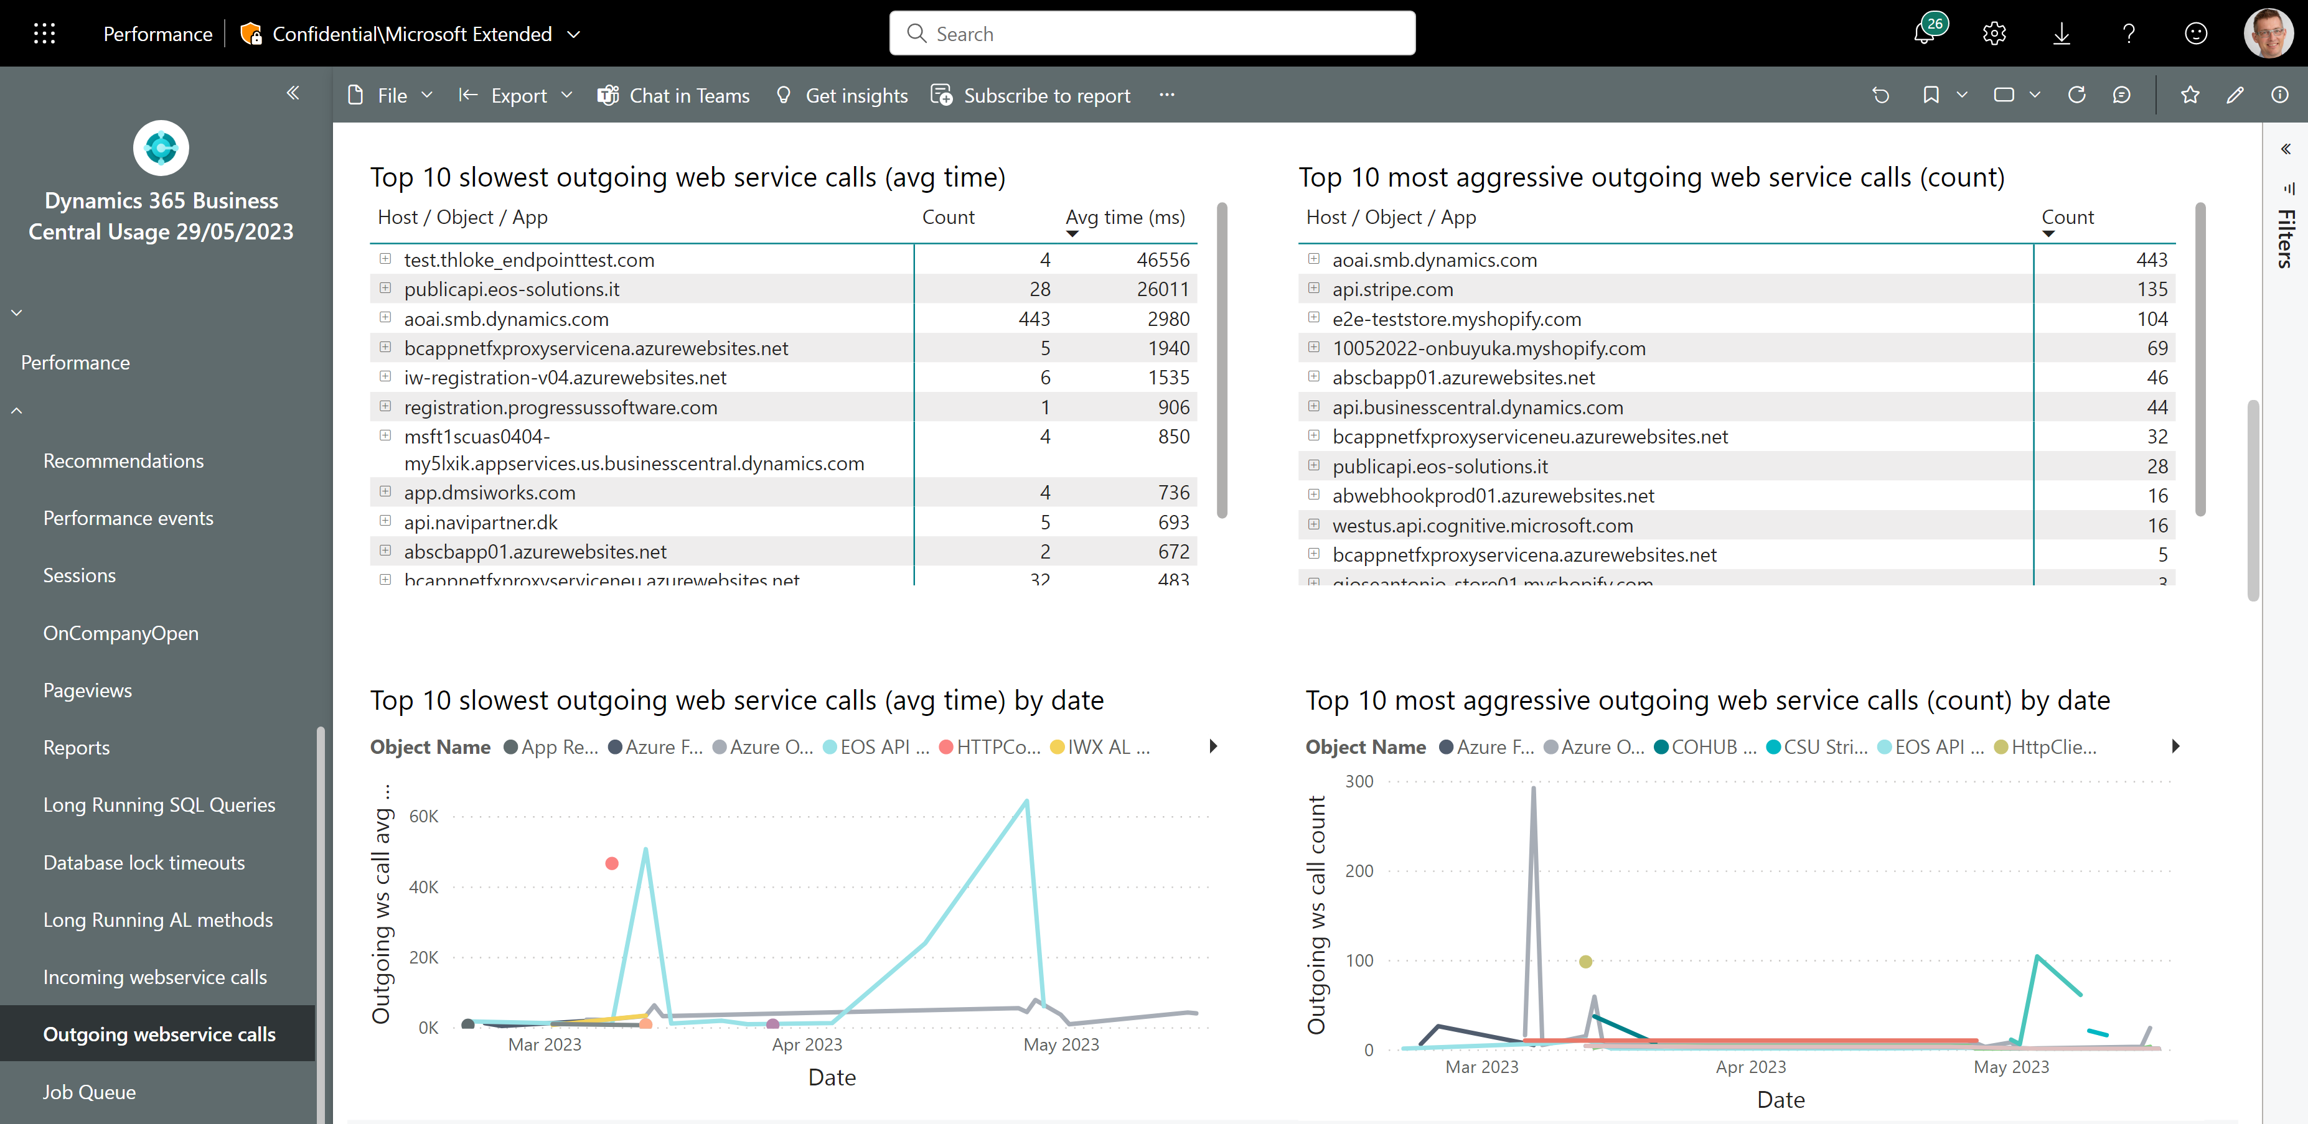
Outgoing web service performance - 1
Tune slow endpoints
Reduce aggressive calls

Slide 13
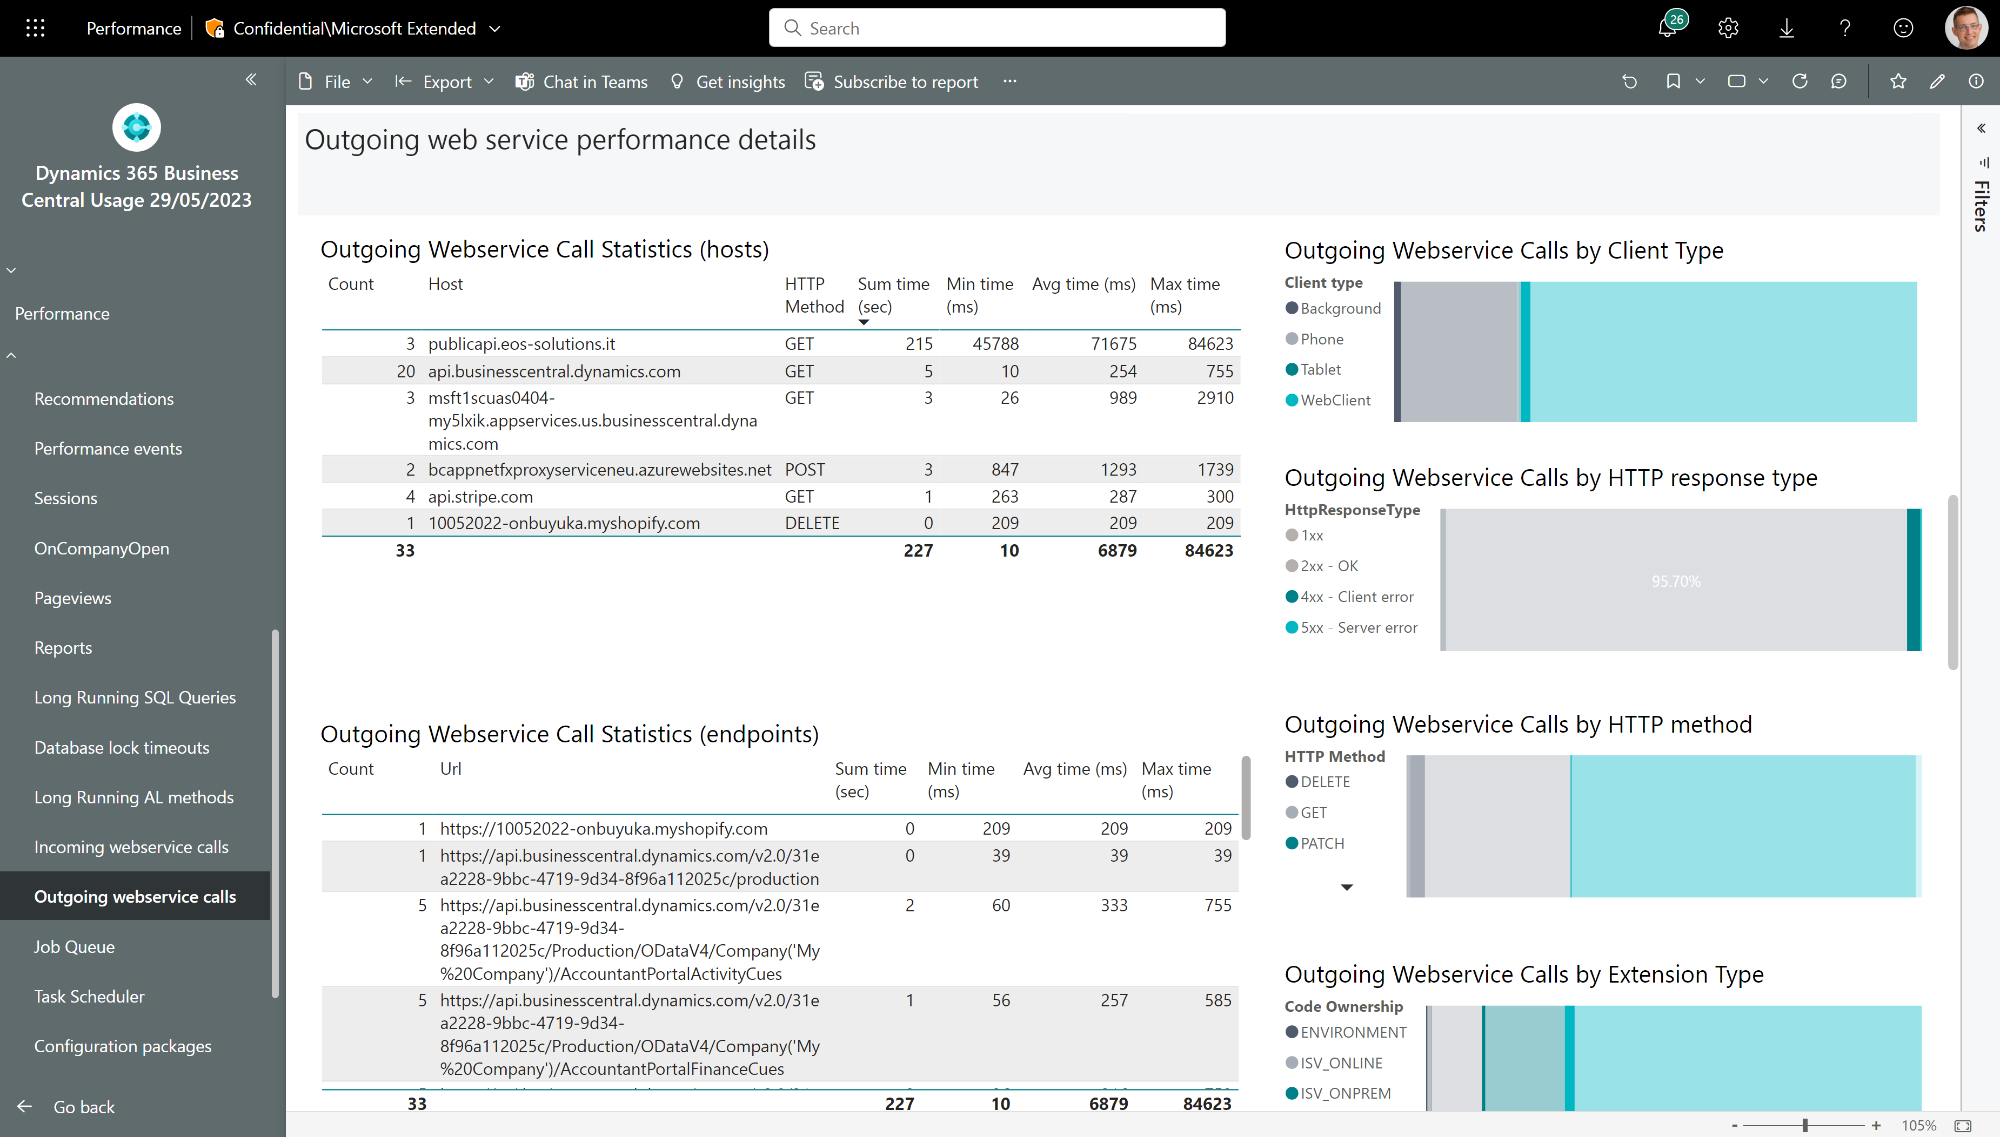
Outgoing web service performance - 2
Fix errors on these endpoints
Filter to only show errors

Slide 14
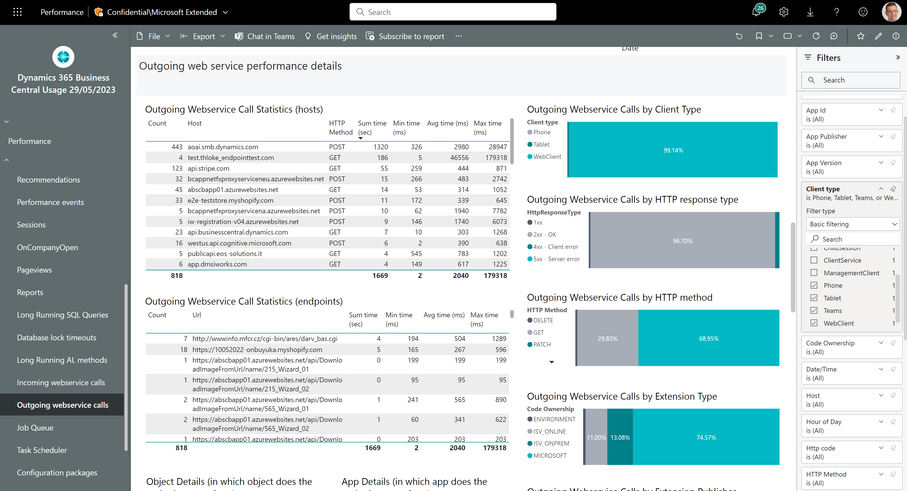
Outgoing web service performance - 3
Tune these – users wait for them in the UI
Filter to only show UI clients

Slide 15
Administration

Slide 16
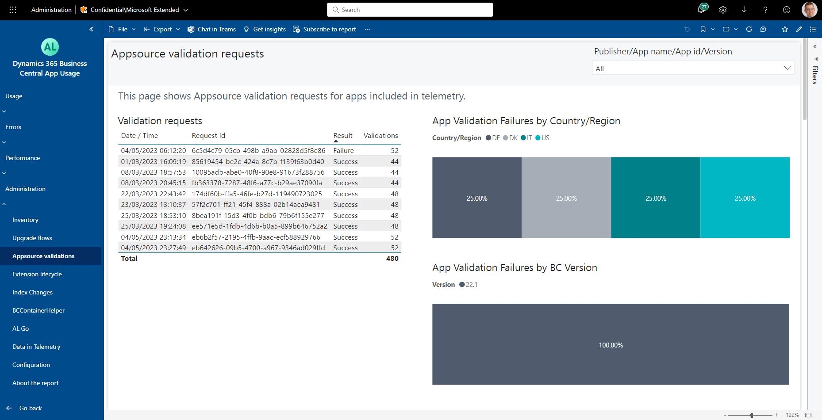
How to see the Appsource validation results
See failures by country/region
See failure rates by version

Slide 17
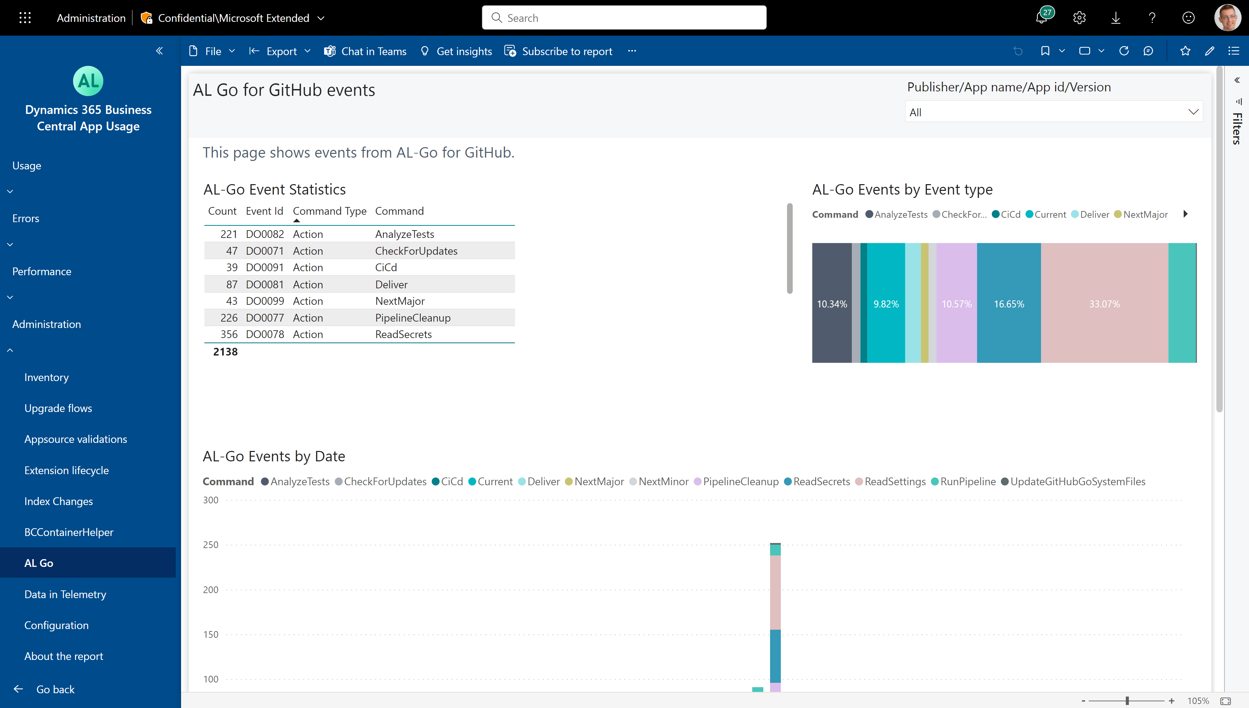
How to see the usage of AL-GO for Github

